Slide 1
What is AI?
AI or Artificial Intelligence is the idea that intelligence can be defined so precisely that we can make an make a machine perform all the required steps to become intelligent.
One of the fields long term goals is general intelligence, making machine that can think like humans.

Slide 2
Why is AI suddenly so popular?
The popularity of AI is mainly based on two factors, the increased computational powers of modern computers and the availability of huge datasets.
AI like people gain experience from stimuli that explain the world (data). This data is used to make predictions on how to act. The more information, the better the predictions. This is true both for people and machines!

Slide 3
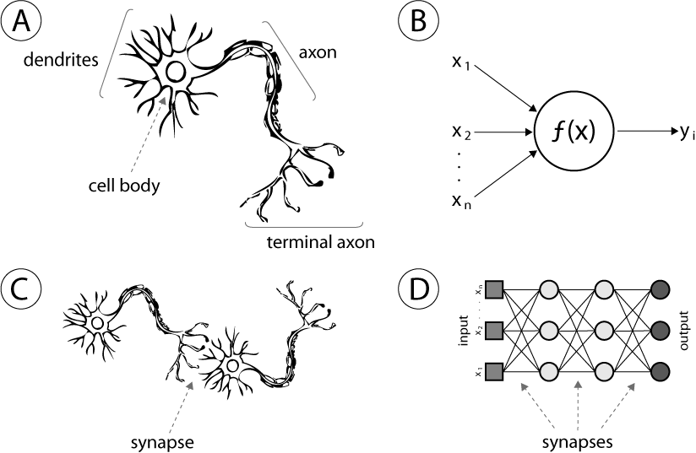
AI and neuroscience
AI and neuroscience are two fields that are becoming more and more intertwined.
The most effective forms of AI are based on theories for how the brain works. Artificial neural networks are modeled on the biological neural networks of the brain.
The convolutional neural networks used for image classifications are modeled on theories of how the visual cortex in mammals work (and they can now classify images better than humans on some tasks!)

Slide 4

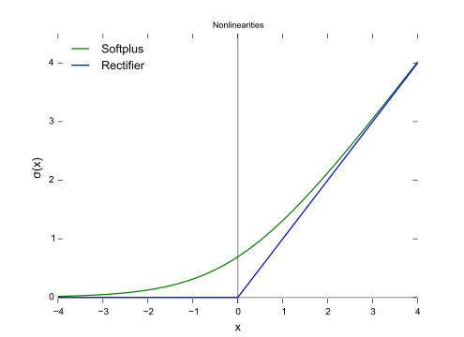
Do I need to learn math in order to work in AI?
It depends. The more math you know the better.
If you know math you can build your own neural networks and implement machine learning algorithms published in AI research papers.
But you can start out making use of powerful libraries for AI technology (Keras, Tensorflow) without a full mathematical understanding of how the libraries work.
The best advice is to start doing stuff and learn the math along the way.
RELU activation function

Slide 5
Math of deep learning
Math of deep learning
AI draws math from three different sources, linear algebra, calculus and statistics.
Linear algebra
http://machinelearningmastery.com/linear-algebra-machine-learning/
Calculus
https://www.umiacs.umd.edu/~hal/courses/2013S_ML/math4ml.pdf
Statistics
http://machinelearningmastery.com/crash-course-statistics-machine-learning/
Neural network from scratch
Building a simple neural network from scratch. Walkthrough and experiments.
http://www.wildml.com/2015/09/implementing-a-neural-network-from-scratch/

Slide 6
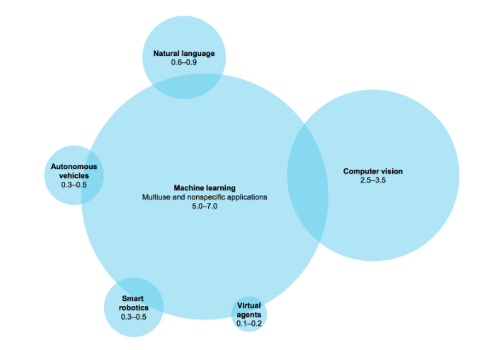
What is machine learning?
Machine learning is a part of AI. It is the subfield of computer science that, according to Arthur Samuel in 1959, gives "computers the ability to learn without being explicitly programmed."

Slide 7
Supervised and unsupervised learning
Machine learning is divided into two parts. Supervised and unsupervised learning. Most of the advanced in the last couple of years have made using supervised learning.
Supervised learning
Supervised learning divides data into training and test data. The algorithms trains on the training data to make accurate guesses and then makes educated guesses on the test data. Examples, most artificial neural networks (feedforward, CNN, LSTM)
Unsupervised learning
No training data is provided. The algorithms needs to figure out optimal strategies on its own. Example, evolutionary algorithms and self-organizing map (SOM) and adaptive resonance theory (ART)

Slide 8
Types of machine learning
Decision tree learning Association rule learning Artificial neural networks Deep learning
Inductive logic programming Support vector machines Clustering Bayesian networks
Reinforcement learning Representation learning Similarity and metric learning Sparse dictionary learning
Genetic algorithm Rule-based machine learning Learning classifier systems

Slide 9
Data and machine learning,
Machine learning is a way to make advanced statistical models using math. It’s a way to make a computer guess.
Machine learning models are fantastic with access to good data. However machine learning models can’t perform magic.
Garbage in = Garbage out
Take a moment and think about what problem you are trying to solve? What data do you need for solving your problem?

Slide 10
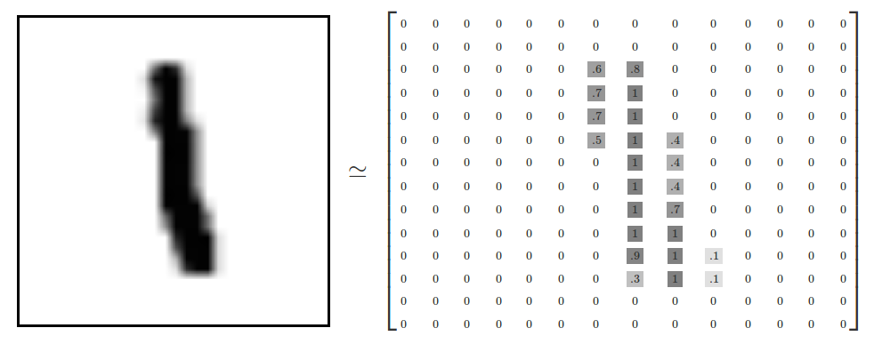
Classic machine learning datasets
MNIST
MNIST is a dataset of handwritten digits. It is the hello world of machine learning. The goal with MNIST is to classify (guess) which handwritten digit is displayed by use of a machine learning model.
http://yann.lecun.com/exdb/mnist/
IRIS
IRIS is another equally famous machine learning dataset. Iris is a dataset for classifying different types of flowers.
https://archive.ics.uci.edu/ml/datasets/iris

Slide 11
How to get data for machine learning
Open datasets on Kaggle
Here are places you can find ready made datasets for machine learning
http://kaggle.com/
Here is a list of all the datasets available at Kaggle with a link on where to download them.
Here is a google doc with information about AI that contains a list to all the datsets on Kaggle.
https://docs.google.com/document/d/1TOC41vbdTZpyzM6nz7KV6v_S4W_KfpK4EMQ-LUAkki4/edit?usp=sharing
Scrape data for machine learning
Scraping is another way to get data. Scraping means to request data from websites and store it offline for later analysis.
Here you can learn more about scraping.
https://www.dataquest.io/blog/web-scraping-tutorial-python/

Slide 12
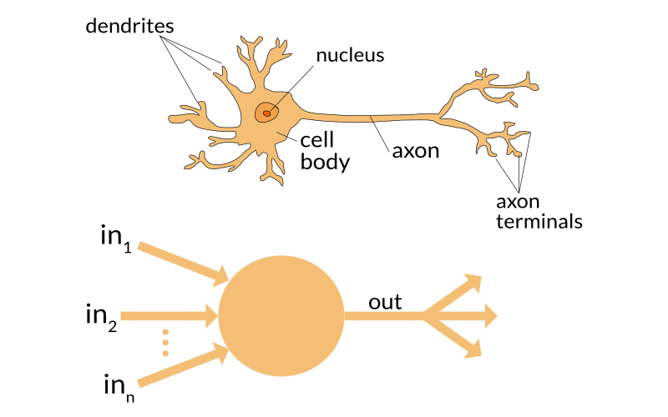
What is an artificial neural network
An artificial neural network is a form of machine learning algorithm that is modelled on how we suppose the brain functions.
The first artificial neural network, the perceptron

Slide 13
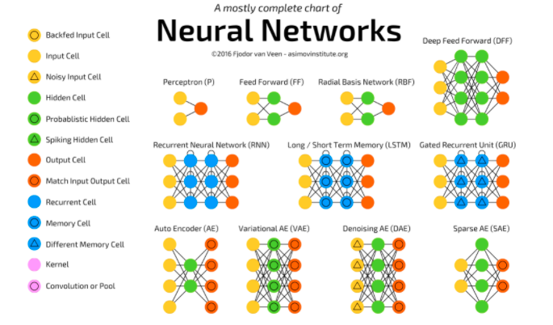
Different types of artificial neural networks

Slide 14
Technology to use to work with artificial neural networks
Python
The war over what programming language to use in data science is over. Python won. The biggest machine learning libraries are built in Python (Tensorflow, Keras). Just use Python. It’s fantastic.

Slide 15
Python libraries to use for machine learning
Numpy
NumPy is the fundamental package for scientific computing with Python. It contains among other things:
a powerful N-dimensional array object
sophisticated (broadcasting) functions
tools for integrating C/C++ and Fortran code
useful linear algebra, Fourier transform, and random number capabilities
Besides its obvious scientific uses, NumPy can also be used as an efficient multi-dimensional container of generic data. Arbitrary data-types can be defined. This allows NumPy to seamlessly and speedily integrate with a wide variety of databases.
NumPy is licensed under the BSD license, enabling reuse with few restrictions.
Numpy is used in AI for building a neural network from scratch among other things.

Slide 16
Python libraries for machine learning
Pandas
Pandas is a library for working with arrays
Creates dataframes for working with high dimensional arrays
Great for working with CSV files
Scikitlearn
Simple and efficient tools for data mining and data analysis
Built on NumPy, SciPy, and matplotlib
Matplotlib
Visualisation library for statistic

Slide 17
Python libraries for machine learning
Jupyter notebooks
Awesome interactive python notebooks running on your local machine
Installation
http://jupyter.org/
Here is a huge list of Jupyter Notebooks used in data science.
https://github.com/jupyter/jupyter/wiki/A-gallery-of-interesting-Jupyter-Notebooks
All our examples are stored in Jupyter Notebooks.

Slide 18

Tensorflow
What is Tensorflow?
Tensorflow is Google Machine Learning library. It is open sourced and an incredible percentage of the progress made in AI in the last years has been done using Tensorflow. It is the de facto standard in machine learning. Google is betting all it’s weight on AI becoming the future of tomorrow and open sourcing Tensorflow is Googles attempts to become the leader in the AI field. Currently it is working really well and Google is seen by many as the leader of AI.
Installation
https://www.tensorflow.org/install/
Training your first model in Tensorflow
MNISTS for beginners
https://www.tensorflow.org/get_started/mnist/beginners
MNISTS for experts
https://www.tensorflow.org/get_started/mnist/pros

Slide 19
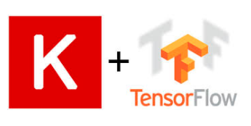
Keras
What is Keras?
Keras is an API on top of Tensorflow that makes it much easier to get started with machine learning.
How do I get started with Keras?
The best way to get started is either with a tutorial or by exploring your own datasets.
Keras
https://keras.io/
Keras machine learning examples
https://github.com/fchollet/keras/tree/master/examples
Keras tutorials
https://github.com/bcarlyle/Momentum-AI-machine-learning-course/blob/master/lesson1/Getting%20started%20with%20AI.ipynb

Slide 20
Lets train our first artificial neural network!
Now it’s time to train our first artificial neural network.
Follow this link to open up the first dataset in a Jupyter notebook.
https://github.com/bcarlyle/Momentum-AI-machine-learning-course/blob/master/lesson1/Getting%20started%20with%20AI.ipynb

